Slide 1
Analytic Trigonometry
Barnett Ziegler Bylean

Slide 2
Chapter 2
Trigonometric functions

Slide 3
recap
In ch 1 we first defined angles – our way of measuring them was based on a circle
We then narrowed our focus to angles of a triangle and explored similarity of triangles
We finally zeroed in on right triangles and defined and named 6 ratios- forming relations between angles and these ratios that are functions
These functions however, have a very limited domain -

Slide 4
Ch 2 – section 1
Degrees and radians

Slide 5
Radian
For various reasons the degree measurement used with triangle trigonometry is cumbersome and restrictive
Therefore a new unit of measure was devised
Definition:
1 radian = the angle which subtends an arc
that is 1 radius long
Since a full circle is an arc of 360⁰ with an arc length(circumference) of 2π
360⁰= 2π radians

Slide 6
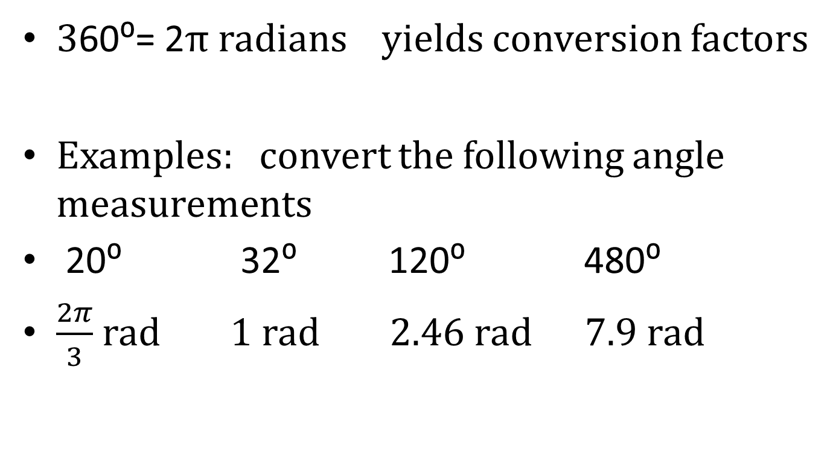
Conversion factor
360⁰= 2π radians yields conversion factors
Examples: convert the following angle measurements
20⁰ 32⁰ 120⁰ 480⁰
$\frac{2π}{3}$ rad 1 rad 2.46 rad 7.9 rad

Slide 7
Arc length/sector area revisited
since 1 radian subtends an arc with length of 1 radius
ө radian subtend an arc with length of ө radii
in other words s = өr hence $\frac{s}{r}=θ$
And $\frac{A_{s}}{πr^{2}}=\frac{θ}{2π}$ which becomes $A_{s}=\frac{θr^{2}}{2}$
Example: find the angle that subtends a 6cm arc on a circle with a 4 cm radius
Example: find the arc length of an arc subtended by an angle of radian 7 with a 9in radius
Example : given a 22⁰ angle centered in a circle with 10 inch radius, find the length of the arc it subtends
Example: find the area of a sector enclosed by an angle of 1.7 rad with a 4 in radius

Slide 8
Ch2 – section 3
The unit circle

Slide 9
Unit circle viewpoint of trig
Sometimes looking at something from a different viewpoint gives us useful information/tools with which to answer various questions/problems
Defining the trig functions by a triangle restricts their use to angles 0 ⁰< ө⁰< 90⁰
By using circles we have determined that angles larger than this and smaller than this exist.
We will now take a second look at our triangle ratios

Slide 10
Addendum
The equation for a circle is :
(x – h)² + (y – k)² = r²
where (h,k) is the point at the center of the circle and r is the radius of the circle

Slide 11
Triangles and circles
For any point (x,y) on circle you can draw an angle in standard position where the terminal side is part of a right triangle with sides that are x any y long and a hypotenuse that is r long.
This triangle is referred to as a reference triangle. Its angle at the origin is called a reference angle
Through this triangle you can associate the six trig ratios with any point on the circle thus expanding our domain to all angles.

Slide 12
Using reference angles to find trig ratios
Given a point (x₁,y₁) you can draw a circle centered at the origin that crosses through the point and has a radius (r)
The equation for the circle is x² + y² = r²
where $r=\sqrt{{\left(x_{1}\right)}^{2}+{\left(y_{1}\right)}^{2}}$
You can then draw an angle in standard position whose terminal side goes through (x₁,y₁) and construct a reference triangle with angle ө at the origin. Although length is usually thought of a positive number we could attach a sign to the length in order to further describe the reference triangle
The side opposite ө has length = y
The side adjacent to ө has length = x
And the hypotenuse of the triangle = r = x² + y²

Slide 13
Using a point on a circle and a reference triangle
Let ө be the angle whose terminal side goes through the given point and ө_{r} be the central angle of the reference triangle
A. (3,4) B. (-4, 7) c. (-2, - 6)
D. $\left(\frac{\sqrt{35}}{7},\frac{\sqrt{14}}{7}\right)$
There is a direct relation between the x coordinate and cos(ө) and the y coordinate and sin(ө).

Slide 14
Defining the trig ratios by the unit circle
given x² + y² = 1 (called the unit circle) then for any point (x,y) on the circle :
cos(ө)= x sin(ө) = y
sec(ө) = 1/x = 1/cos(ө)
csc(ө) = 1/y = 1/ sin(ө)
tan(ө) = y/x = sin(ө)/cos(ө)
cot(ө)= x/y = cos(ө)/ sin(ө)
Note: this definition has done two things
1) it has expanded the domain of the functions
2) it has included negative values for the range of the functions

Slide 15
NOTE
We could have defined the trig ratios from a generalized circle that has a radius of r.
If we had then the definitions would read
cos(ө)=x/r sin(ө) = y/r
sec(ө) = r/x csc(ө) = r/y
But tan(ө) and cot(ө) remain the same as when defined by a unit circle -
Therefore the above relations are true for points not on the unit circle

Slide 16
Using the definitions to evaluate trig functions
Given sin(ө) = $\frac{2}{3}$ and that the angle terminates in the 3rd quadrant :
find exact values for cos (ө) and tan(ө)
given tan(ө) = $\frac{1}{5}$ and cos(ө) <0
find exact values for sin(ө) and sec(ө)

Slide 17
More on Evaluating trig functions- given ө
With a calculator – The calculator will deal with the negative values of both ө and f(ө)
Be certain that you are set in the correct input mode (degrees/radians)
Examples: find sin(ө) cos(ө) tan(ө)
ө = {135⁰, $\frac{5π}{3}$ , 280⁰, ±$\frac{11π}{4}$ }
However, it estimates the irrational values

Slide 18
Chapter 2 – Section 5
Special angles and basic identities

Slide 19
Trig identities
An identity is a variable equation that is known to be always true
In algebra the property statements are identities ex. Commutative property
x +y = y + x
We have already alluded to several trig identities. Knowing them sometimes saves time and energy and sometimes is crucial to working the problem
I find that understanding each set helps me to remember them – you will need to learn them
The textbook lists all pertinent trig identities on its front cover and on a tear out pamphlet. Flash cards might aid you in learning them.
Use of the pamphlet/cards/ or book will be highly limited on tests- probably mostly prohibited

Slide 20
Pythagorean identities
Since x² + y² = 1 for our unit circle
cos²(ө) + sin²(ө)= 1 for all values of ө
Thus sin²(ө) = 1 – cos²(ө)
cos²(ө) = 1 – sin²(ө)

Slide 21
Fundamental trig. identities
$\tan\left(θ\right)= \frac{y}{x}=\frac{sin⁡(θ)}{cos⁡(θ)}$
$\sec\left(θ\right)=\frac{1}{x}=\frac{1}{cos⁡(θ)}$
$\csc\left(θ\right)=\frac{1}{y}=\frac{1}{sin⁡(θ)}$
$\cot\left(θ\right)=\frac{x}{y}=\frac{cos⁡(θ)}{\sin{(θ)}}=\frac{1}{tan⁡(θ)}$
Thus once we determine cos($θ$) and sin($θ$) the other six values are quickly determined

Slide 22
More on identities
We also noted earlier using triangles that complementary angles are related
cos(ө)= sin(90⁰- ө) and
sin(ө) = cos(90⁰- ө)
Written in radian notation cos(ө) = sin($\frac{π}{2}−\text{ө}$) and
sin(ө) = cos($\frac{π}{2}−\text{ө}$)
Ex: cos( 32⁰) = sin(58⁰)
$sin\left(\frac{2π}{5}\right)$ = $cos⁡\left(\frac{π}{10}\right)$
It is also well to note that full rotations ie ө and ө+ 360⁰(n)
or in radians ө+2πn
are co-terminal angles thus have the same trig ratios
example: if sin(x) = .2981 then sin(x +14π) = .2981

Slide 23
And negative angle identities
sin(-x) = - sin(x)
cos(-x) = cos(x)
ө
-ө

Slide 24
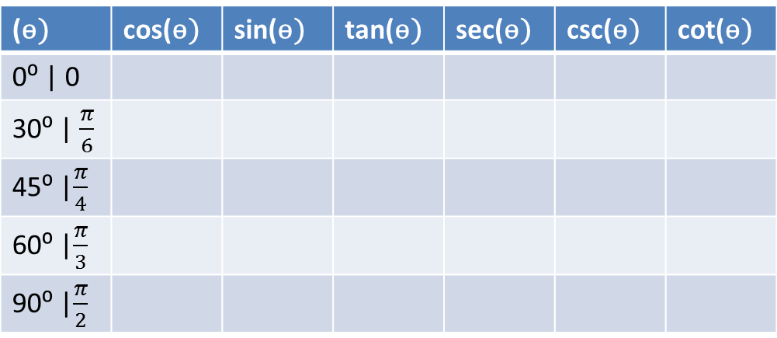
Special angles
Using some basic geometry there are some angles whose trig values can easily be found exactly even though they are irrational
angles that are co-terminal with or reference to:
(ө) | cos(ө) | sin(ө) | tan(ө) | sec(ө) | csc(ө) | cot(ө)
0⁰ | 0
30⁰ | $\frac{π}{6}$
45⁰ |$\frac{π}{4}$
60⁰ |$\frac{π}{3}$
90⁰ |$\frac{π}{2}$

Slide 25
Determine sign
You can memorize the table
Or utilize reasoning using quadrants and a unit circle sketch
Ө values | Cos | sin | tan | sec | csc | cot
0 + 2πm < ө < π/2 + 2πm | pos | pos | pos | pos | pos | Pos
π/2 + 2πm < ө < π +2πm | neg | pos | neg | neg | Pos | Neg
π + 2πm < ө < 3π/2 + 2πm | neg | neg | pos | neg | neg | Pos
3π/2 + 2πm < ө < 2π +2πm | pos | neg | neg | pos | neg | neg
Ө = 0 + 2πm | 1 | 0 | 0 | 1 | undef | undef
Ө= π/2+ 2πm | 0 | 1 | undef | undef | 1 | 0
Ө=π+ 2πm | -1 | 0 | 0 | -1 | undef | undef
Ө= 3π/2+ 2πm | 0 | -1 | undef | undef | -1 | 0

Slide 26
Finding exact values for special angles
Any angle that is a multiple of the special angles listed in the previous table is either co-terminal to or referenced by one of these angles
Find exact values for: cos($\frac{7π}{6})$ sin$\left(\frac{7π}{3}\right)$
$tan\left(\frac{2π}{3}\right)$ cos(135⁰) sec(- 120⁰)
Find the smallest positive angle such that sin(ө)= -0.5

